Slide 1
Penetration Testing Tools
Lecturer: Ngo Huy Bien
Software Engineering Department
Faculty of Information Technology
VNUHCM - University of Science
Ho Chi Minh City, Vietnam
nhbien@fit.hcmus.edu.vn

Slide 2

Objectives

Slide 3

Contents

Slide 4

References

Slide 5
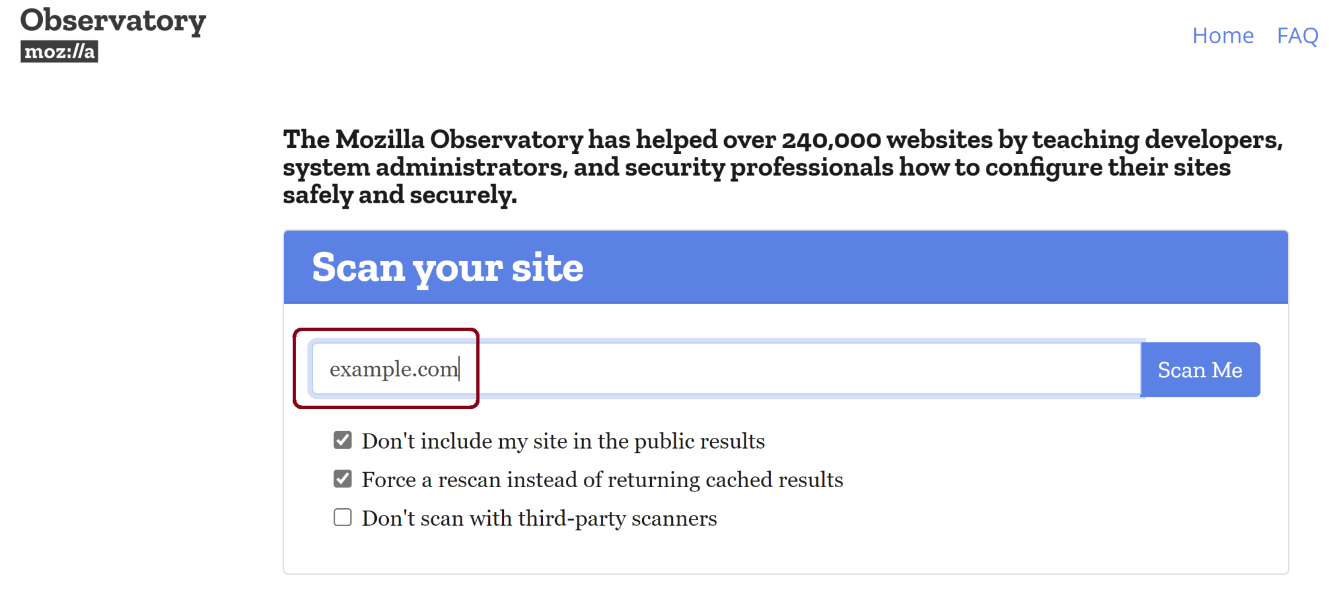
1. Scan a Domain
https://observatory.mozilla.org/

Slide 6
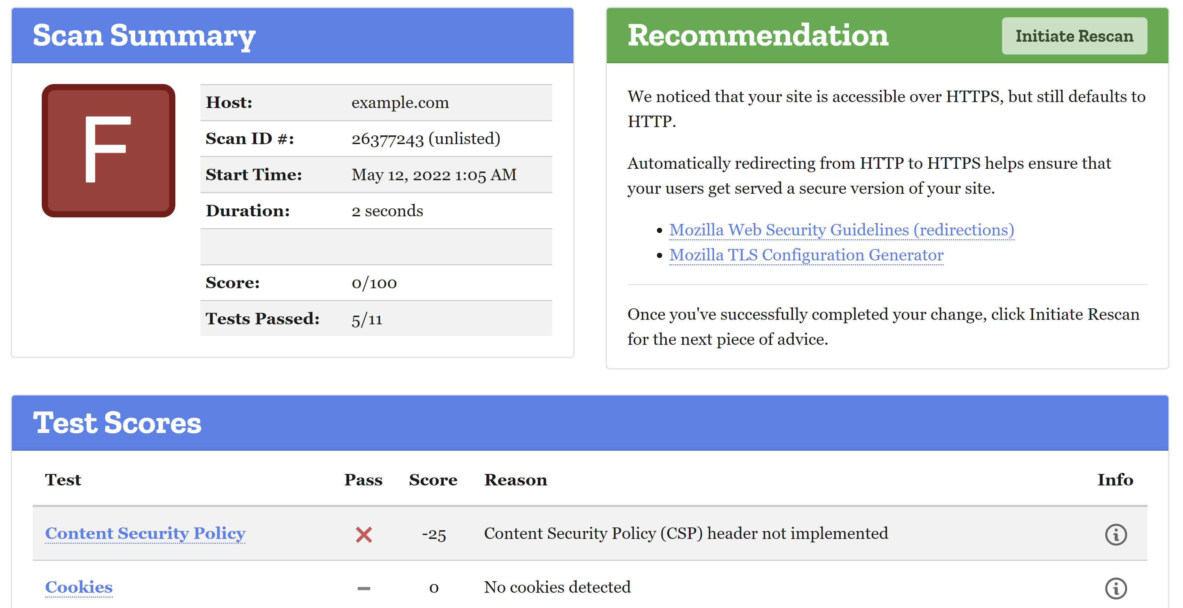
2. Review the Result

Slide 7


Slide 8
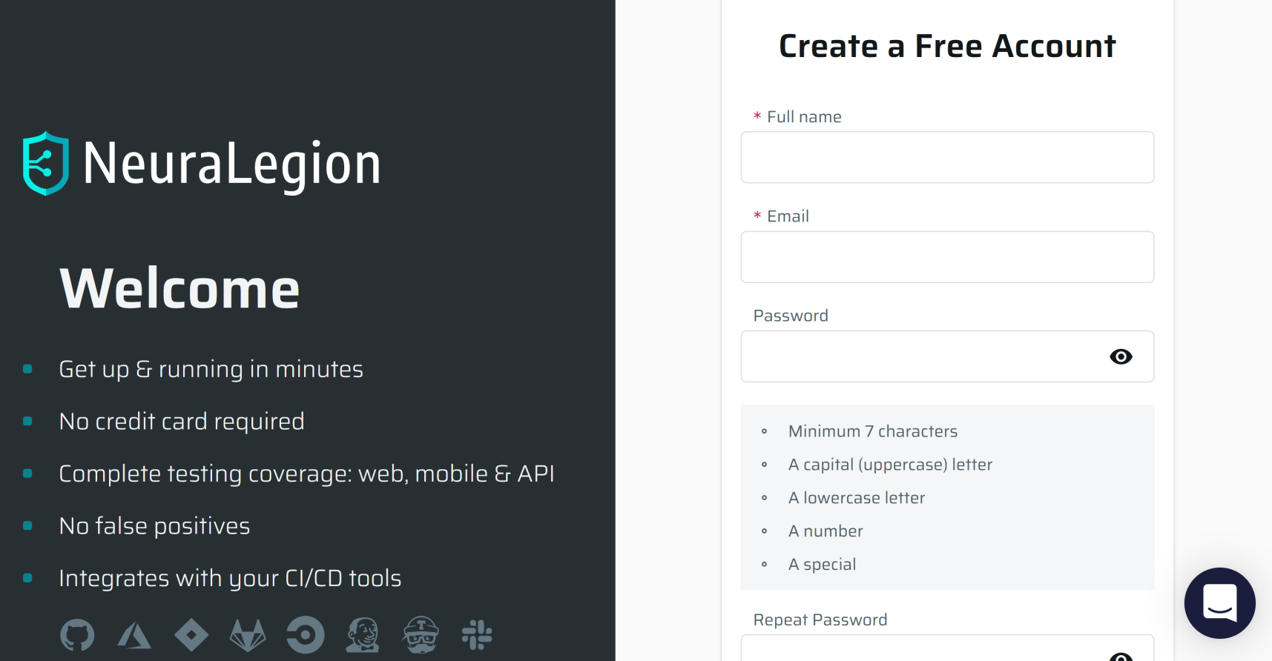
1. Register NeuraLegion Account
https://app.neuralegion.com/signup

Slide 9
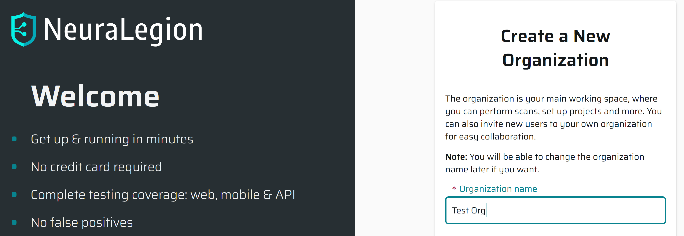
2. Create a New Organization

Slide 10
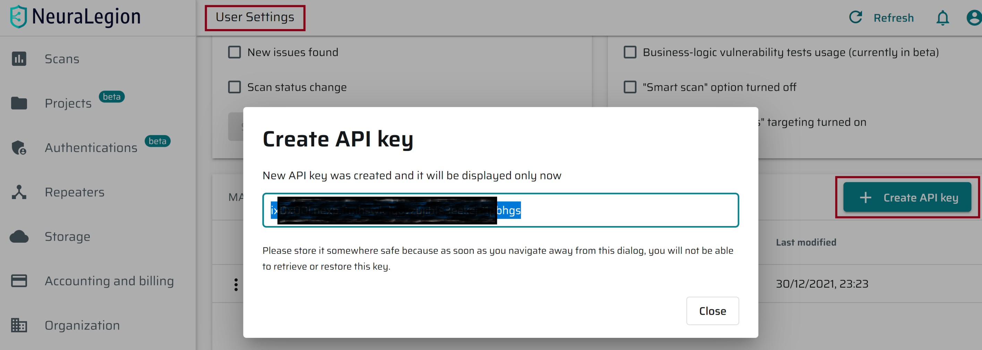
3. Create NeuraLegion API Key
User Settings > Manage your User API keys

Slide 11
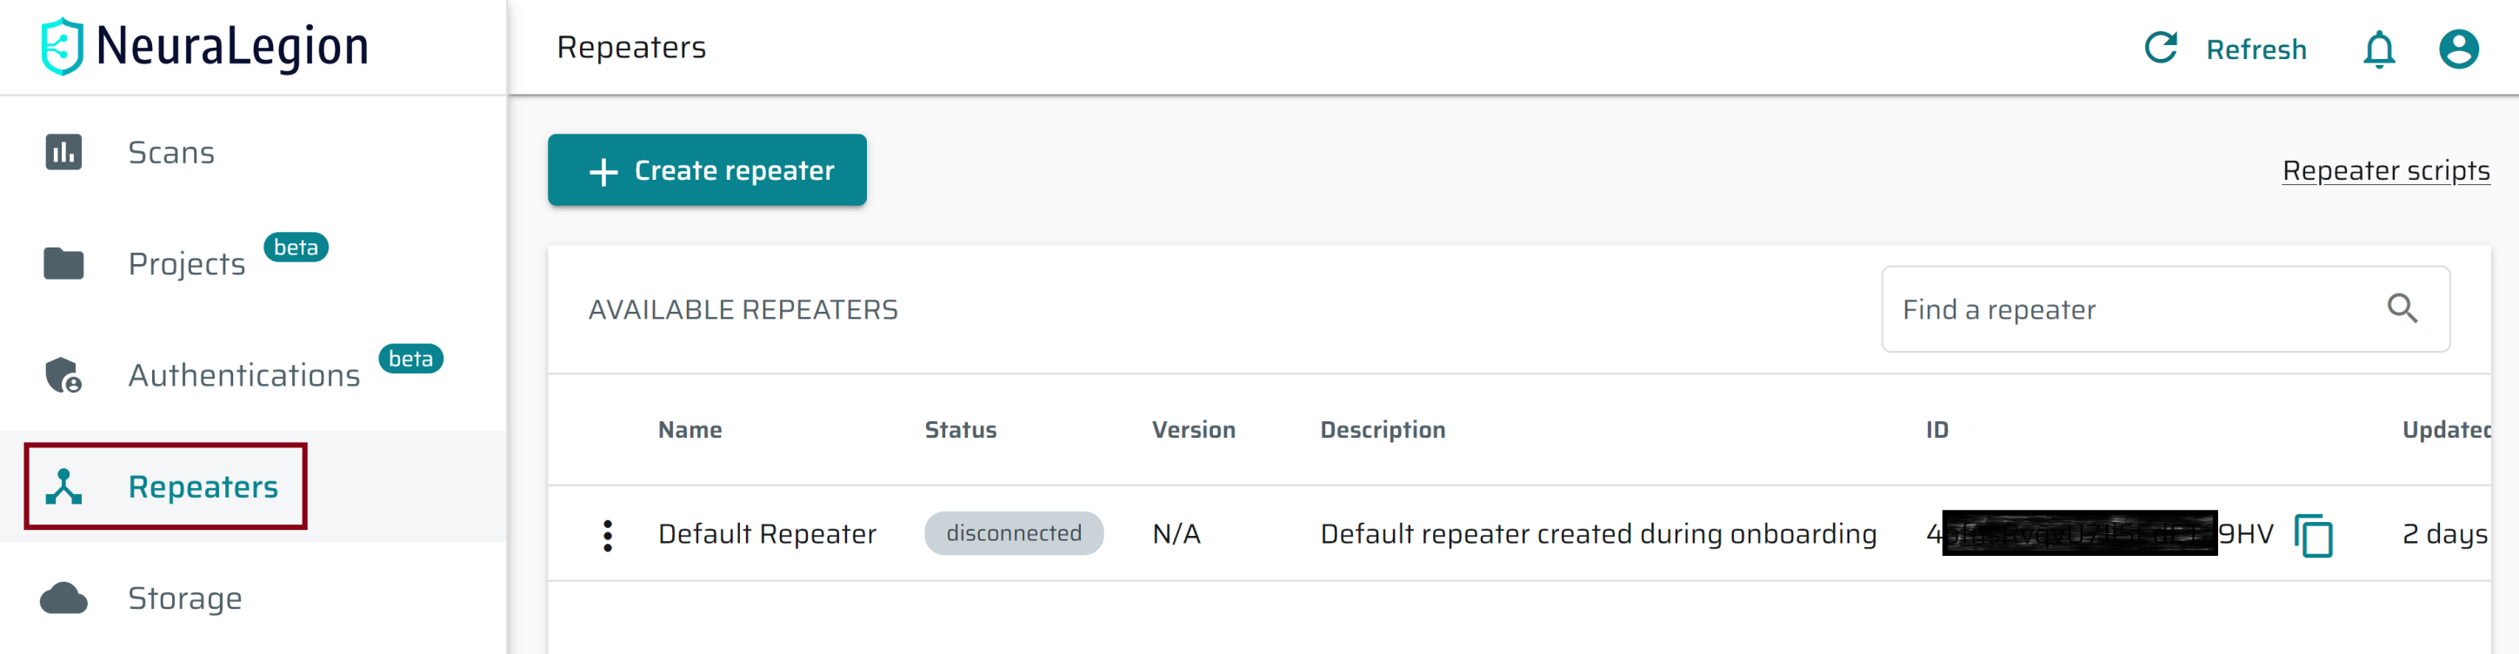
4. Retrieve NeuraLegion Repeater ID

Slide 12
5. Install Node.js 16.14.2
https://nodejs.org/en/

Slide 13
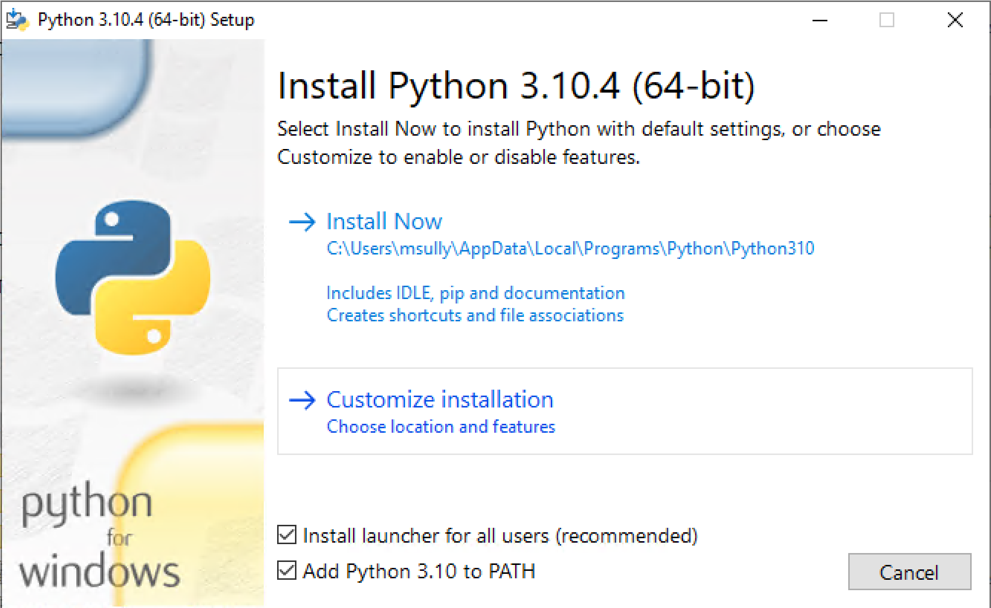
6. Install Python 3.10.4
https://www.python.org/downloads/

Slide 14
7. Install Neuralegion CLI
npm install -g @neuralegion/nexploit-cli
nexploit-cli --version
ISSUE!!!

Slide 15
8. Start a Repeater
https://www.npmjs.com/package/@neuralegion/nexploit-cli
nexploit-cli repeater --token ix0x00l.nexp.itmhswlelyovzyjibfs3eekej21pbhgs --id 4ofnsRvqvU7Ji5EdETa9HV --bus amqps://amq.app.neuralegion.com:5672

Slide 17
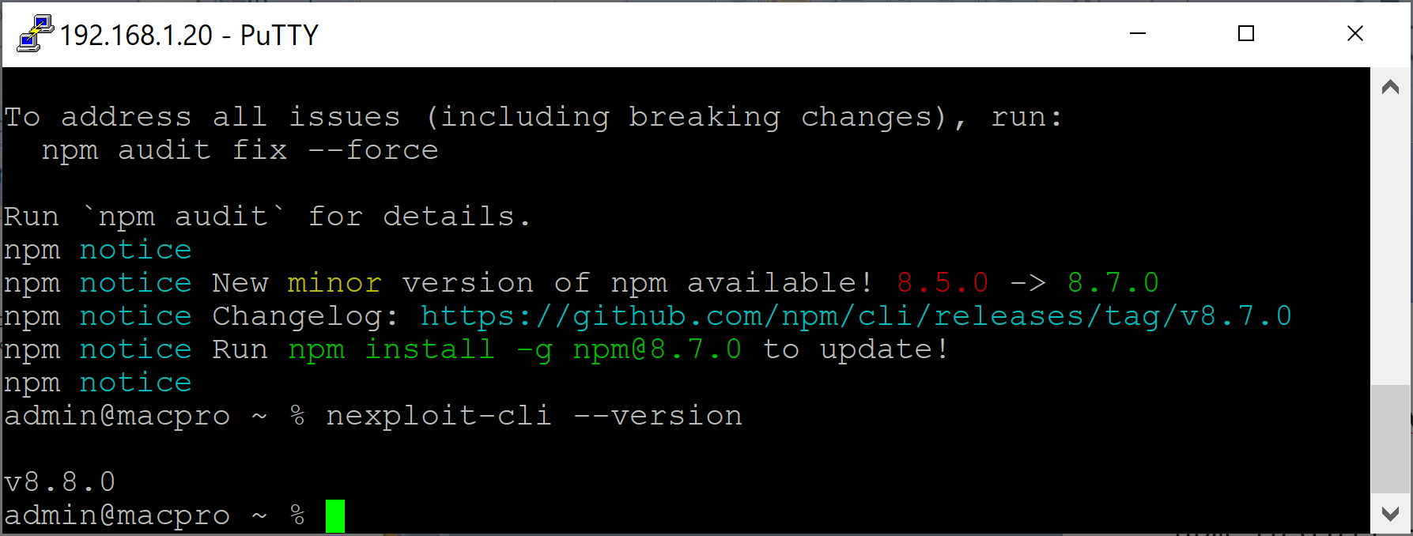
1. Install Neuralegion CLI in macOS
npm install -g @neuralegion/nexploit-cli
nexploit-cli --version

Slide 18
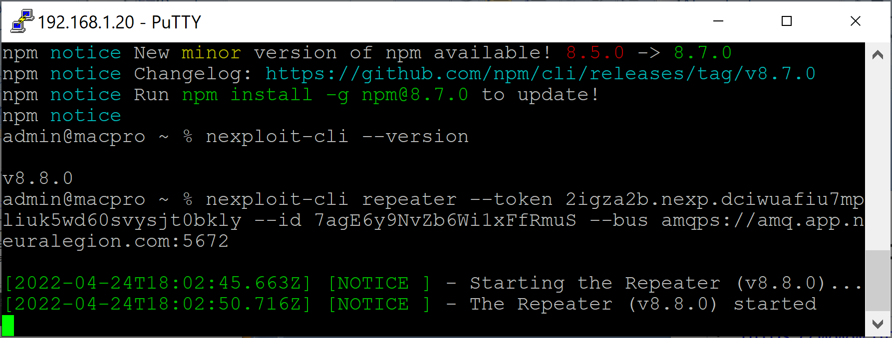
2. Start a Repeater in macOS
https://www.npmjs.com/package/@neuralegion/nexploit-cli
nexploit-cli repeater --token 2igza2b.nexp.dciwuafiu7mpliuk5wd60svysjt0bkly --id 7agE6y9NvZb6Wi1xFfRmuS --bus amqps://amq.app.neuralegion.com:5672

Slide 20
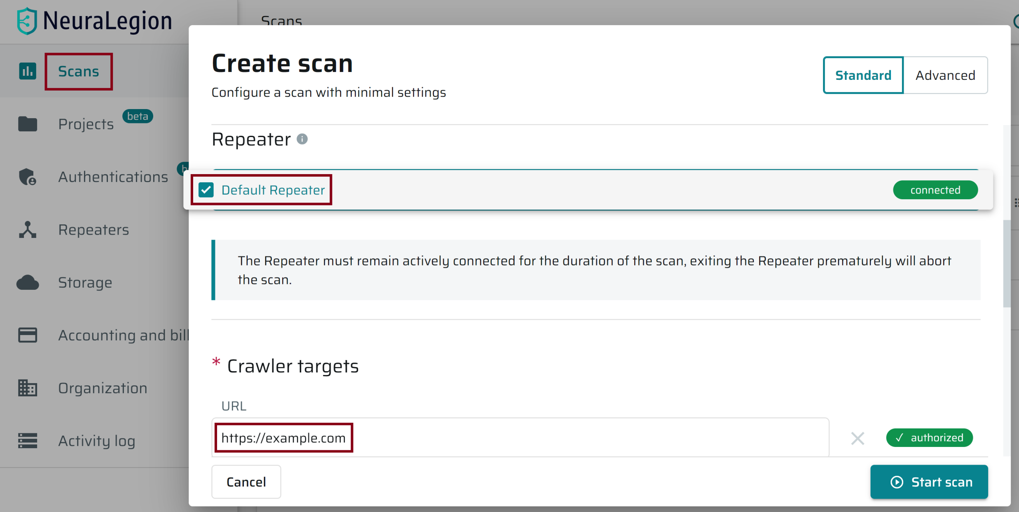
1. Scan a Website

Slide 21
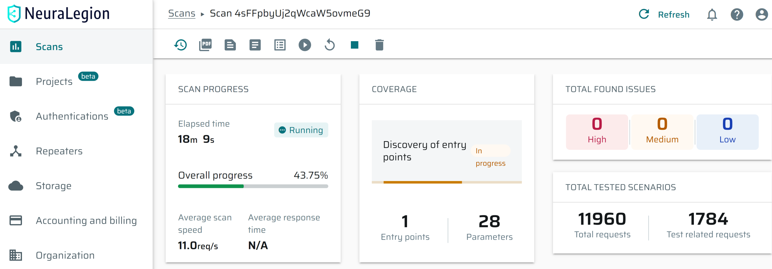
2. Review Scan Progress

Slide 22
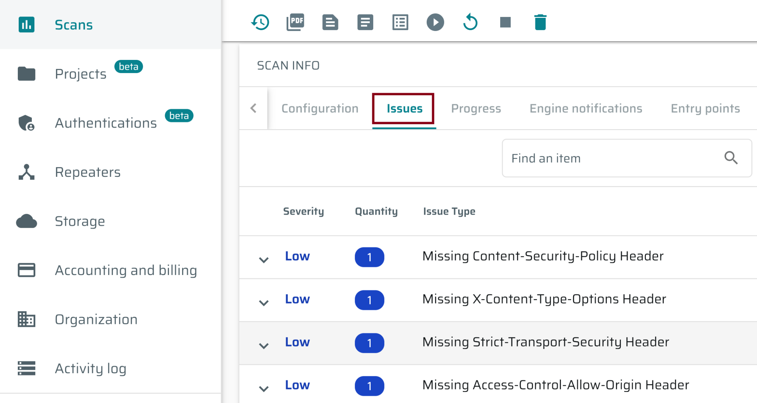
3. Review Issues

Slide 24
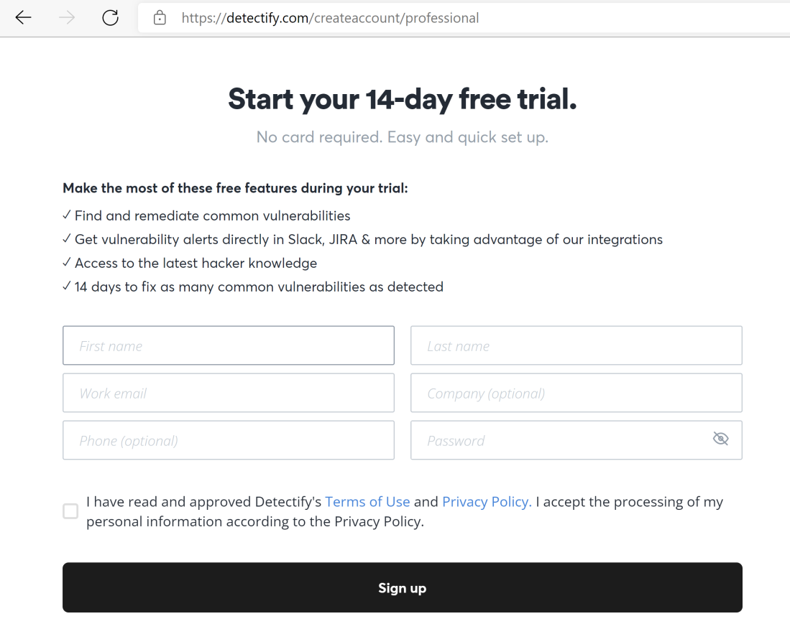
1. Register detectify.com Account
https://detectify.com/createaccount/professional

Slide 25
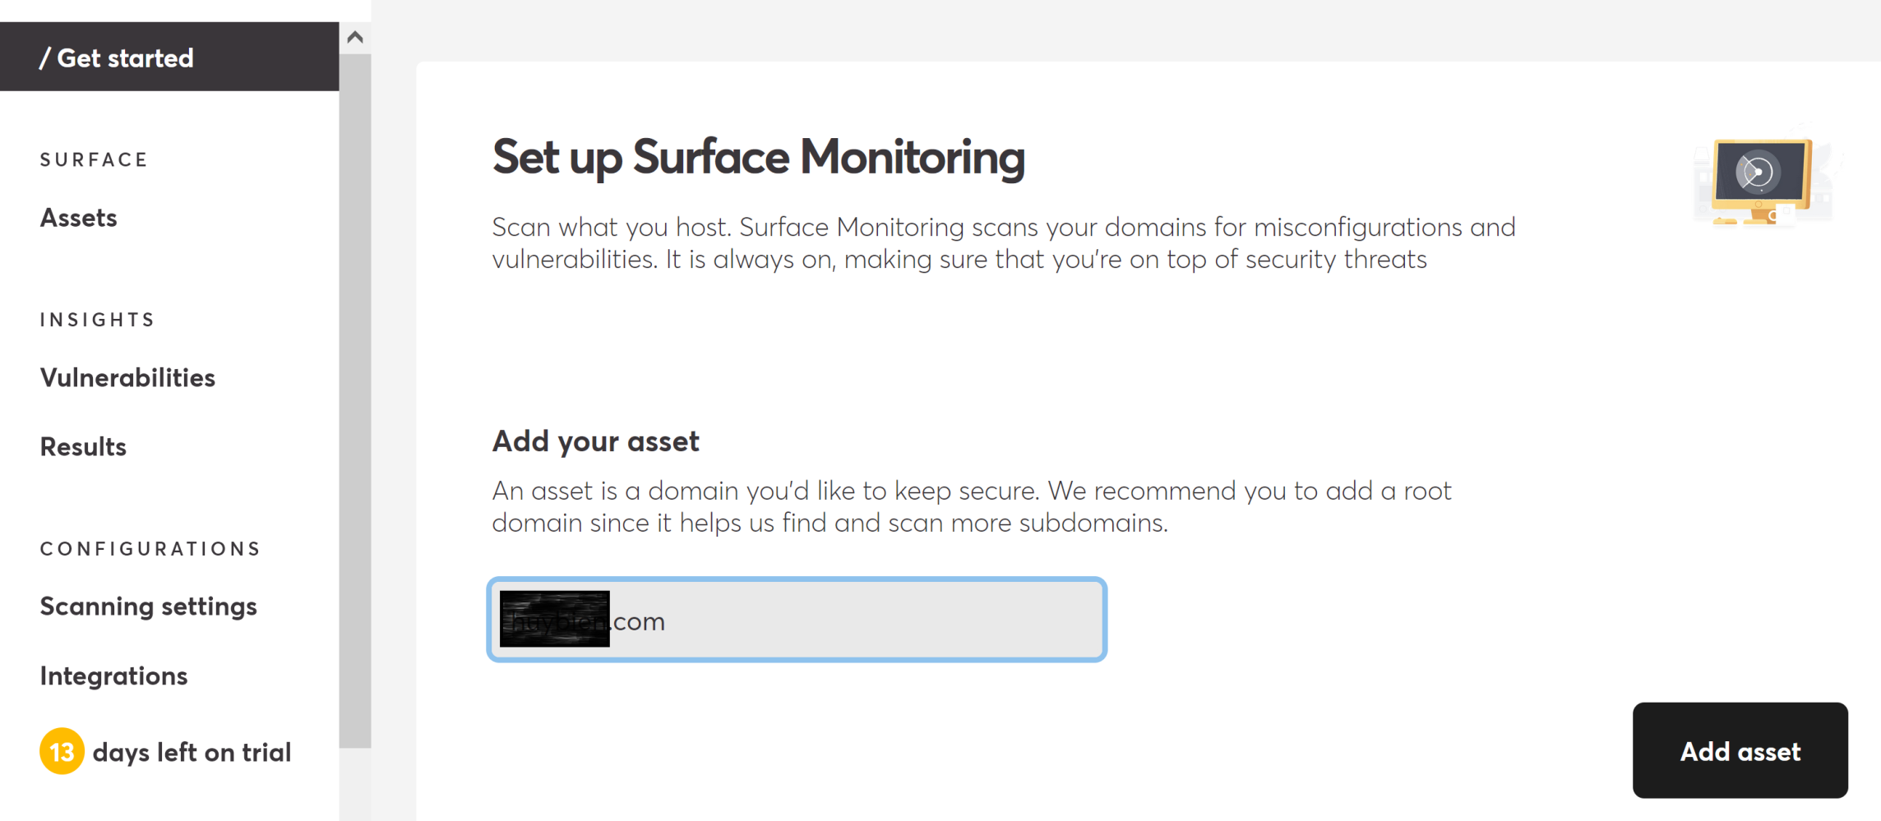
2. Add your asset

Slide 26
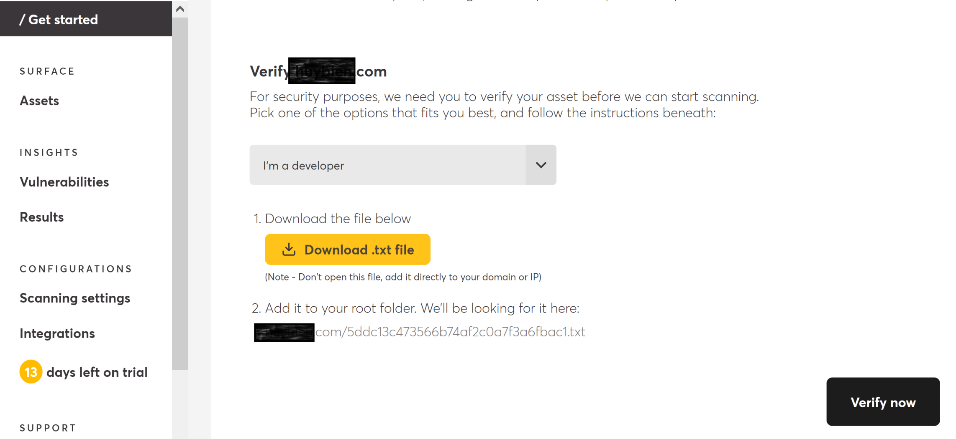
3. Verify your asset
Rename the downloaded file to the .txt file extension if your browser removes its extension.

Slide 27
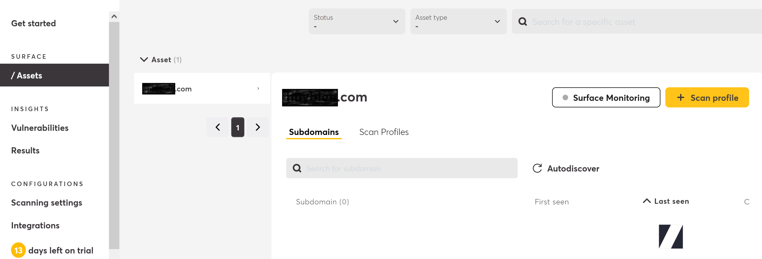
4. Create Application Scan Profile (I)

Slide 28
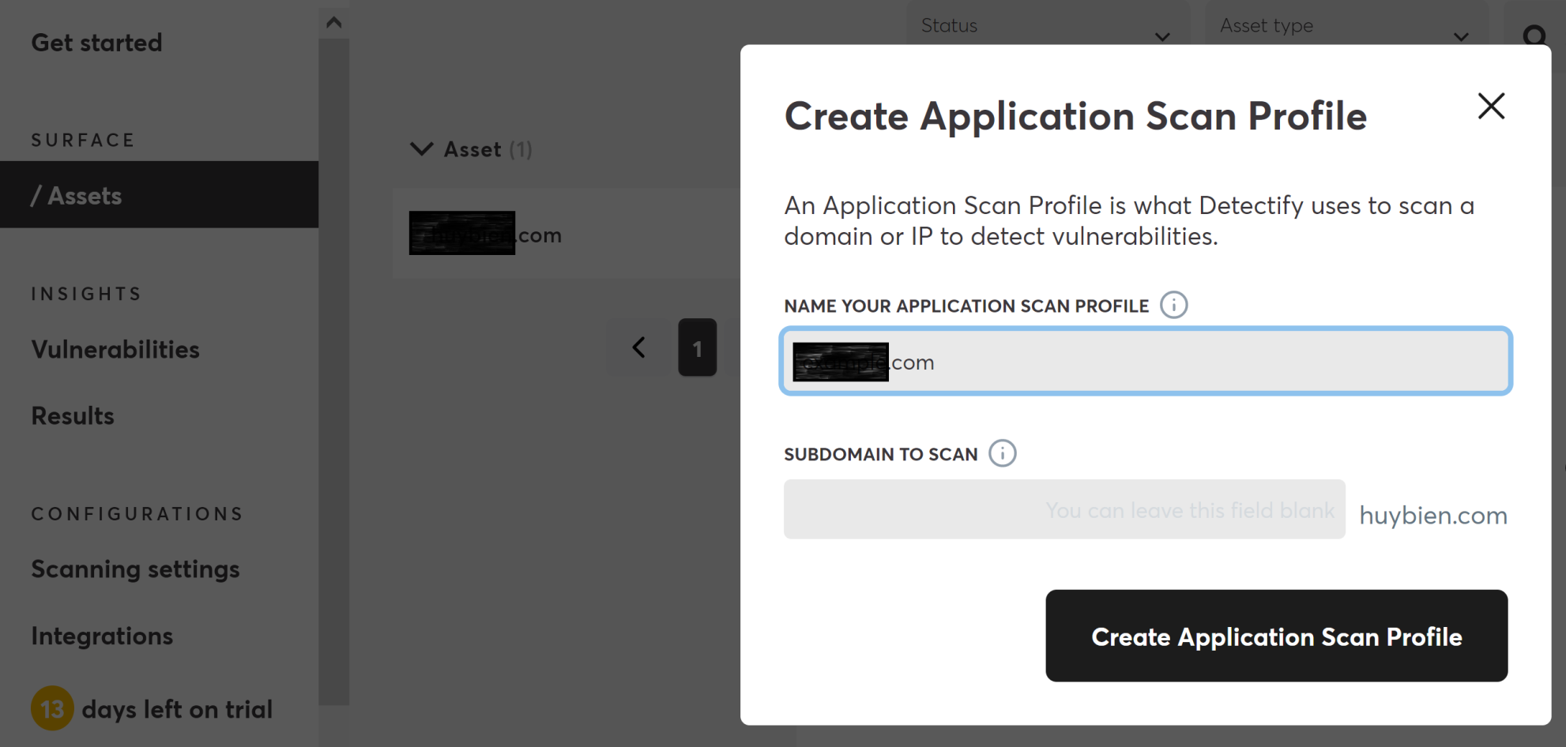
4. Create Application Scan Profile (II)

Slide 29
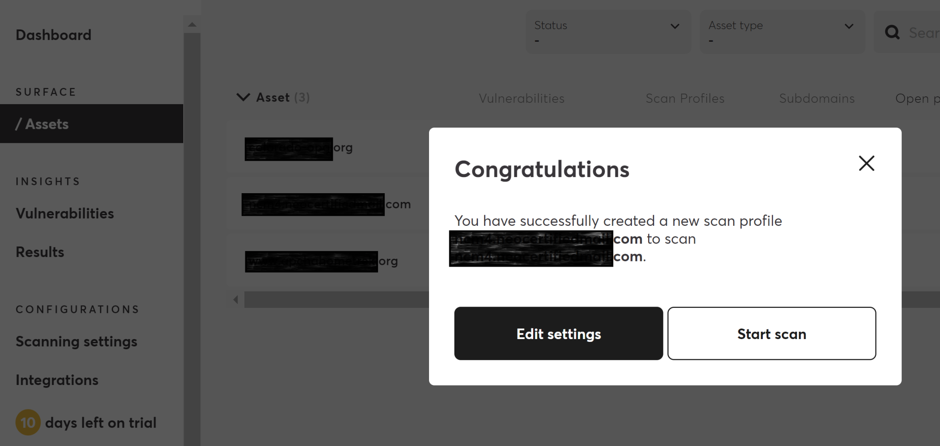
5. Start a Scan

Slide 30
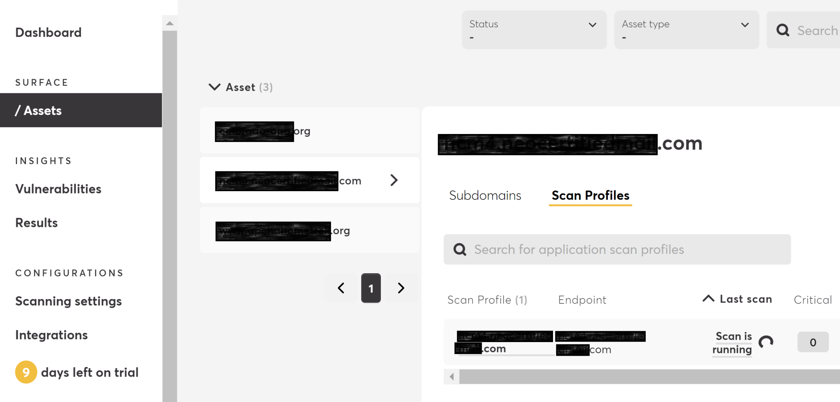
6. Review Scanning Progress

Slide 31
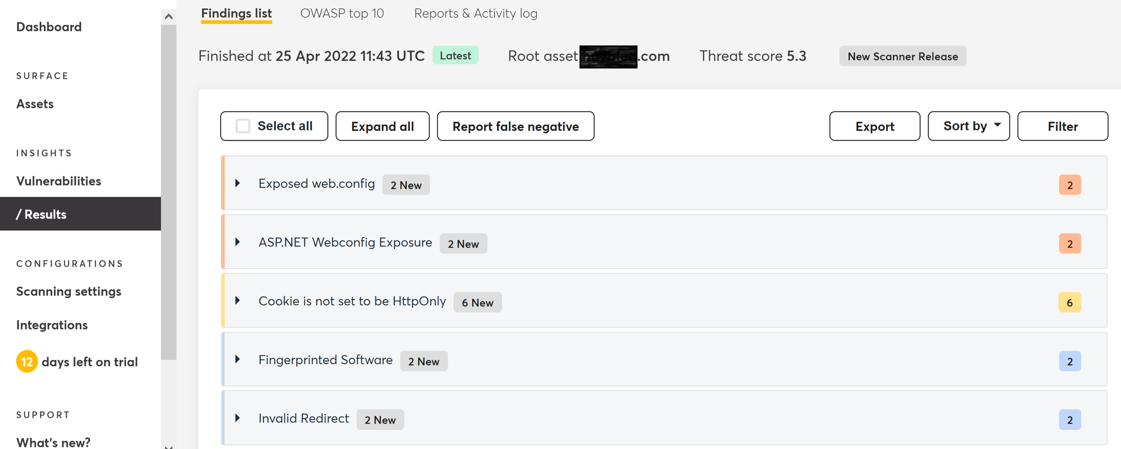
7. Review the Scan Result

Slide 32
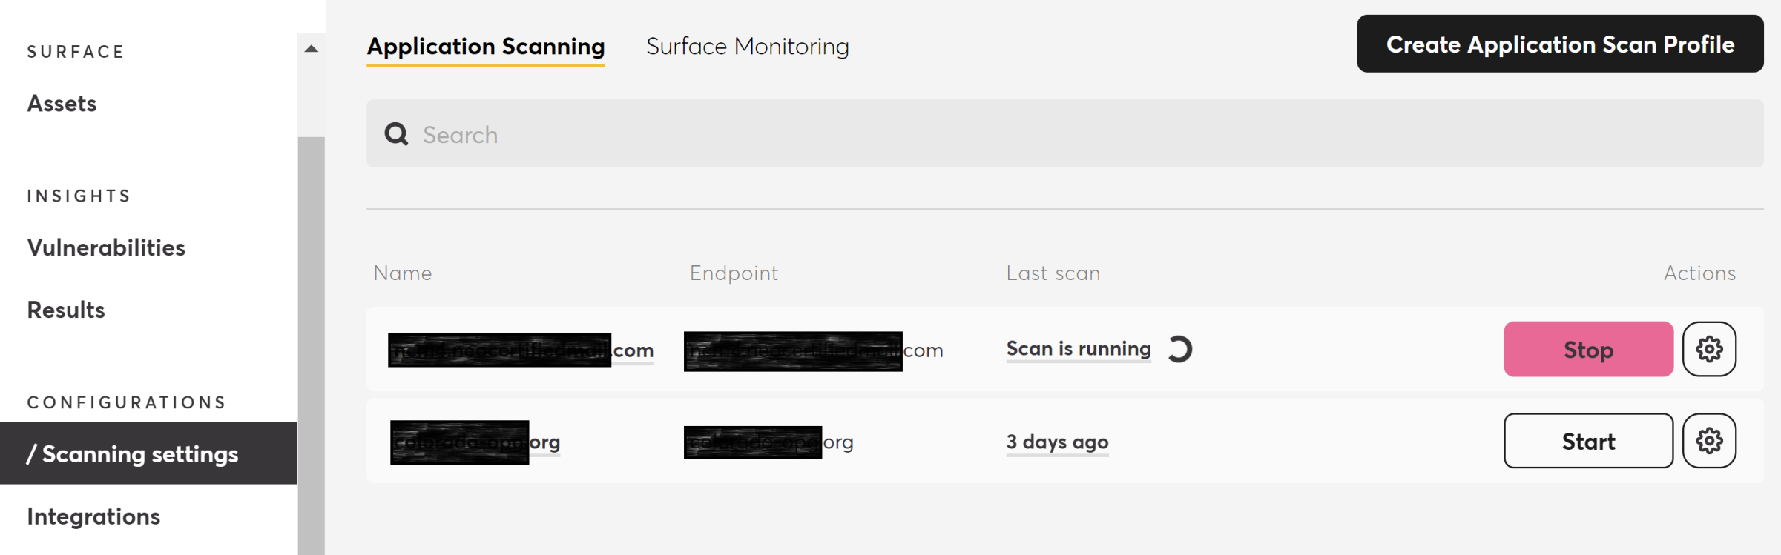
8. Rescan a Website

Slide 33
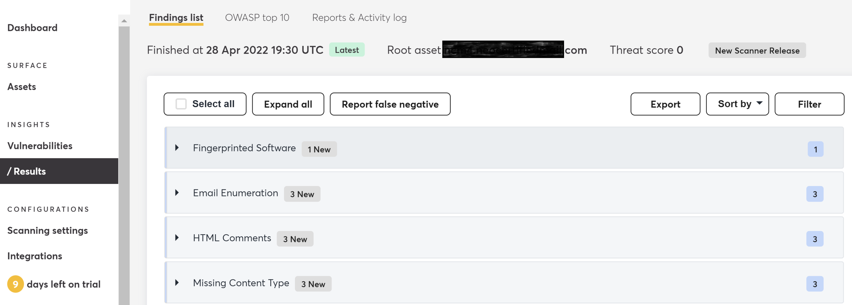
9. Export the Result

Slide 35
Burp Suite
https://portswigger.net/burp/communitydownload

Slide 36
Snyk
https://snyk.io/

Slide 37
Zed Attack Proxy (ZAP)
https://www.zaproxy.org/

Slide 38

Thank You & See You Again

